Slide 1
Engineer a Space Capsule

Slide 2
Step 1

Slide 3
Step 2 – Learn about space capsules.

Slide 4
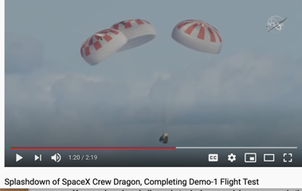
Step 2 – Learn about space capsules.

Slide 5
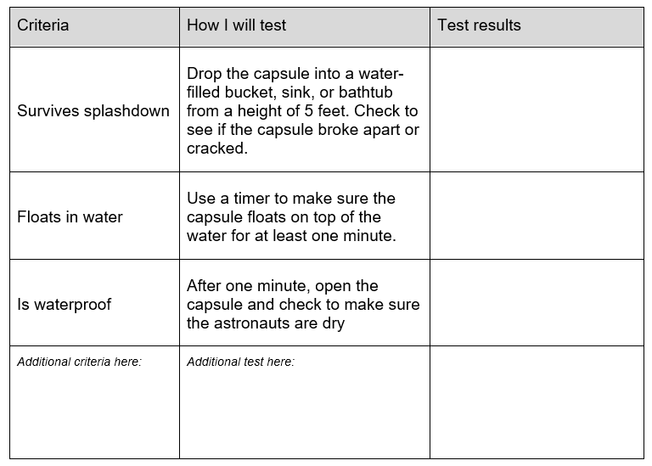
Step 3

Slide 6
Step 4

Slide 7
Step 5
Why do you think the materials you chose will work well?
What properties do they have?
What other materials could you use to create this design?

Slide 8
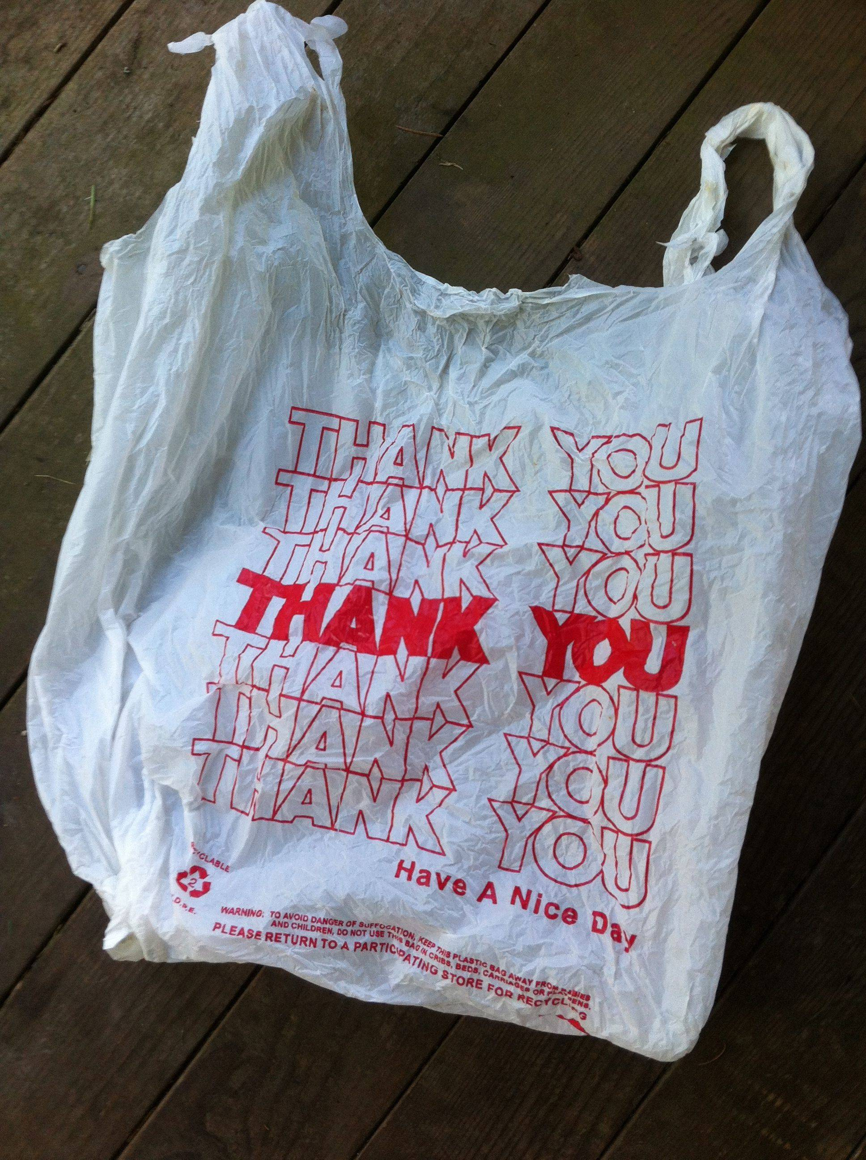
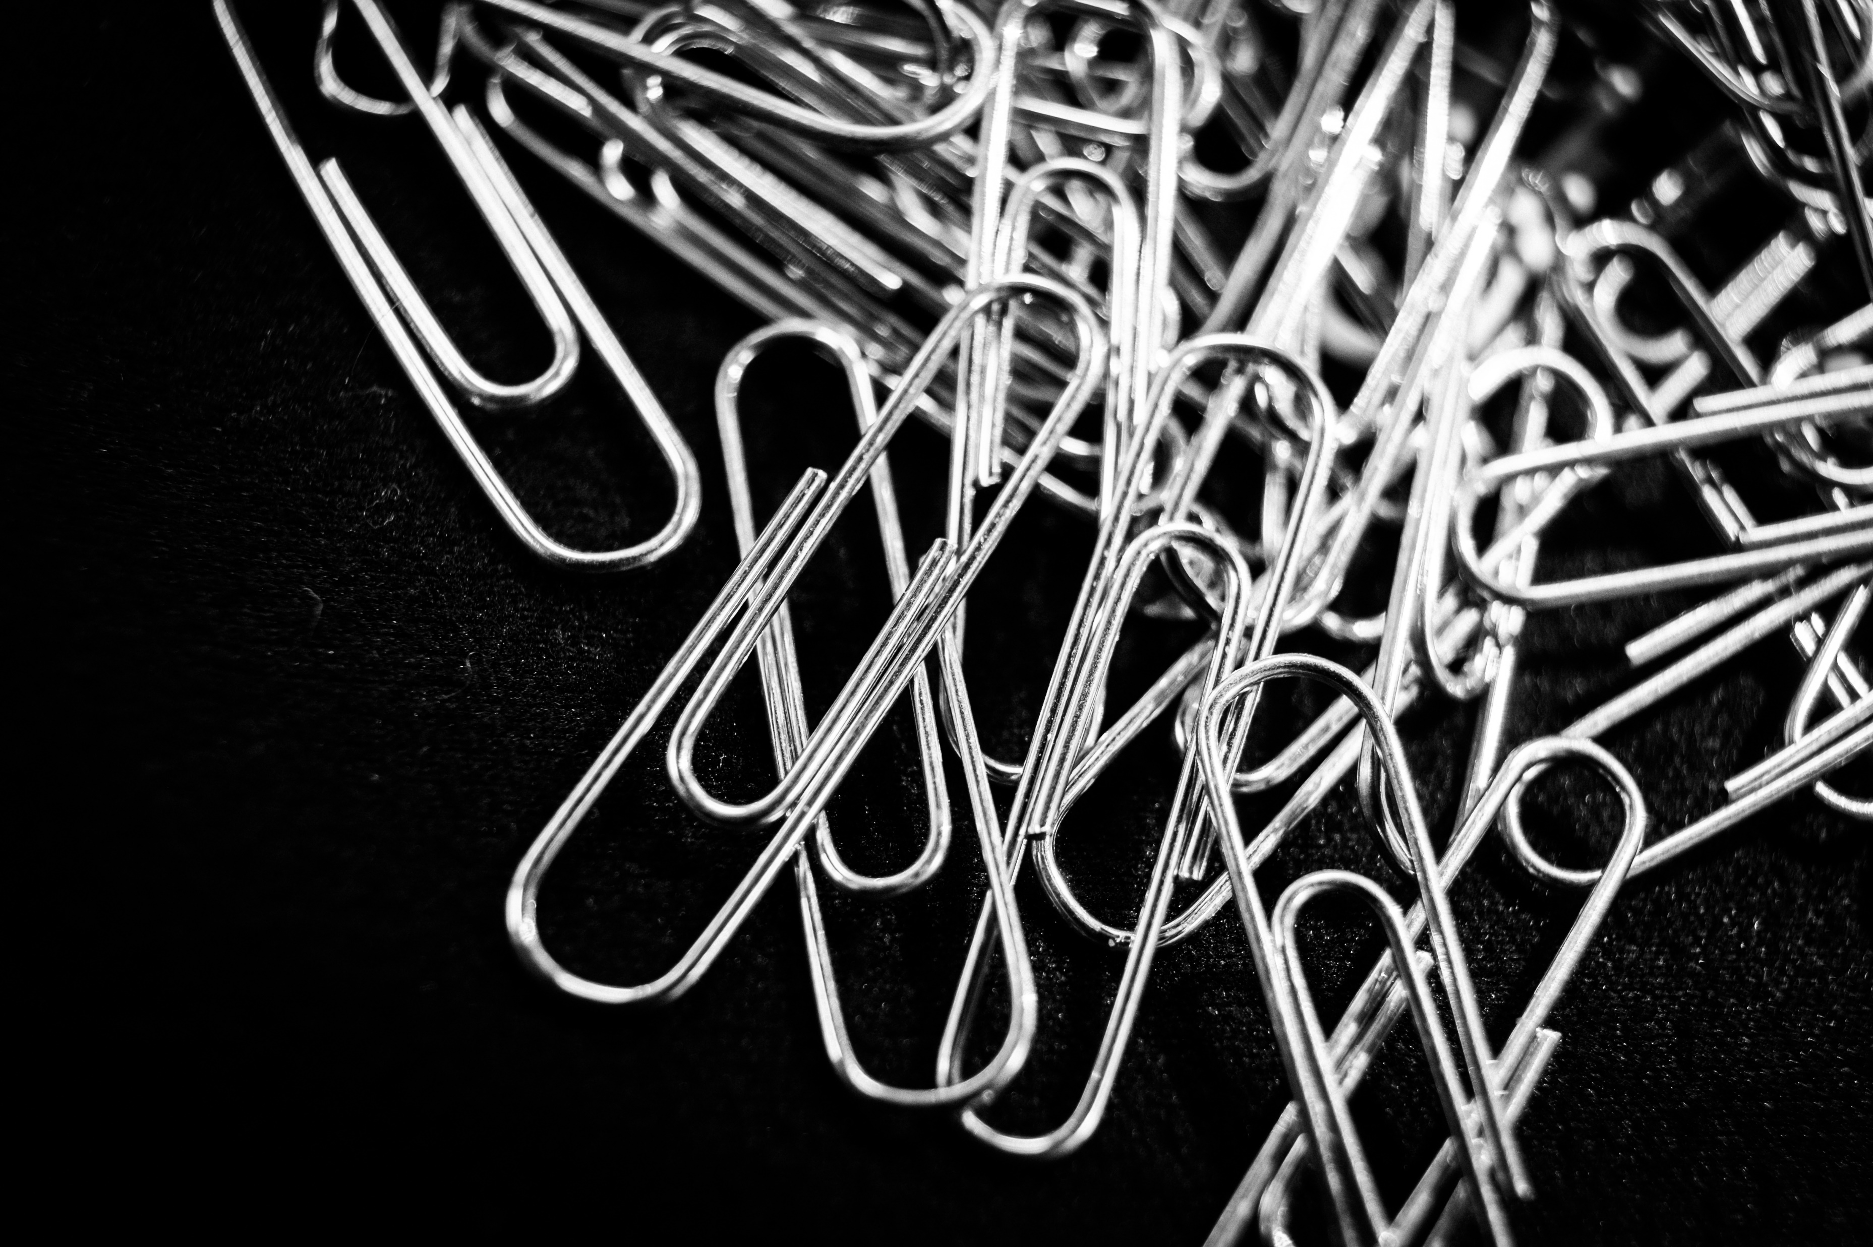
Step 6
bendable
This Photo by Unknown Author is licensed under CC BY-SA
malleable
waterproof
strong
sticky

Slide 9
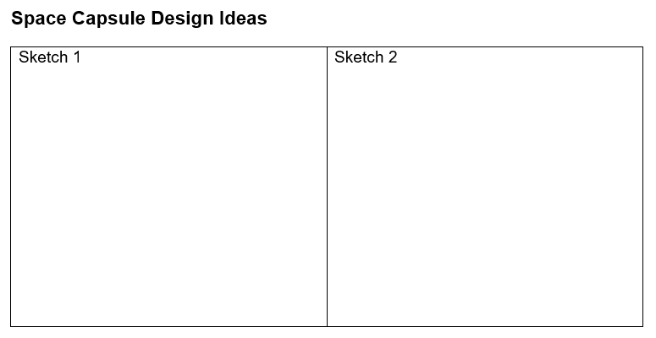
Step 7

Slide 10
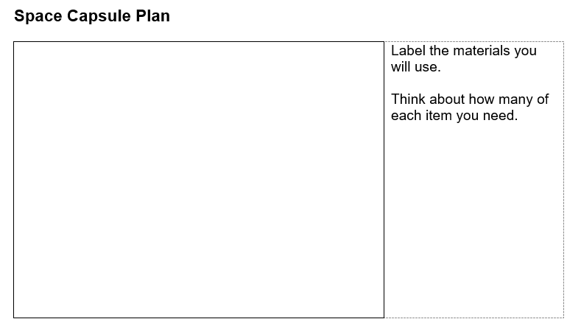
Step 8

Slide 11
Step 9
Follow your plan and create your space capsule!

Slide 12
Step 9

Slide 13
Step 10 – Learn from failure
What can I learn from failure that will help me improve my capsule?
Try it from higher and higher heights until it fails.
Redesign, test, and share your modifications.
Did it perform better?

Slide 14
Step 11
Take turns presenting the results of your engineering work to a partner, group, or instructor and provide feedback to your peers.

Slide 15
Step 12

