Slide 1
Session 6B – Career and Technical Education for the 21st Century Act Opportunities

Slide 2
Speakers
Jeff Cole, Executive Director, Beyond School Bells
Jillian Luchner, Policy Manager, Afterschool Alliance
Chris Neitzey, Director of STEM Initiatives, Afterschool Alliance
Jen Rinehart, Senior Vice President Research and Policy, Afterschool Alliance

Slide 3
Career and Technical Education and Afterschool

Slide 4
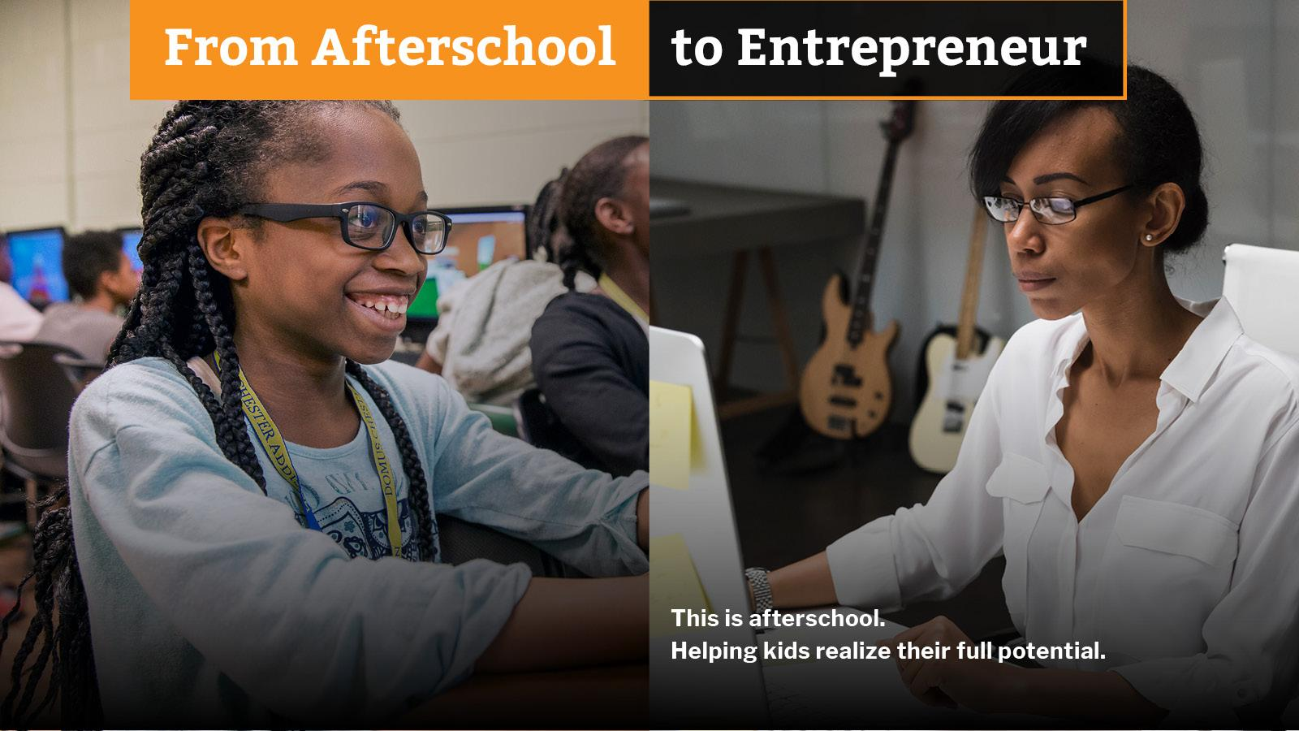
What is Career and Technical Education or CTE?
Career Technical Education (CTE) prepares students of any age with the academic and technical skills, knowledge and training necessary to succeed in future career and to become lifelong learners. ​
From early career exploration to highly technical training​
Includes all sectors and professions

Slide 5
From Vocational Education to CTE (Advance CTE)

Slide 6
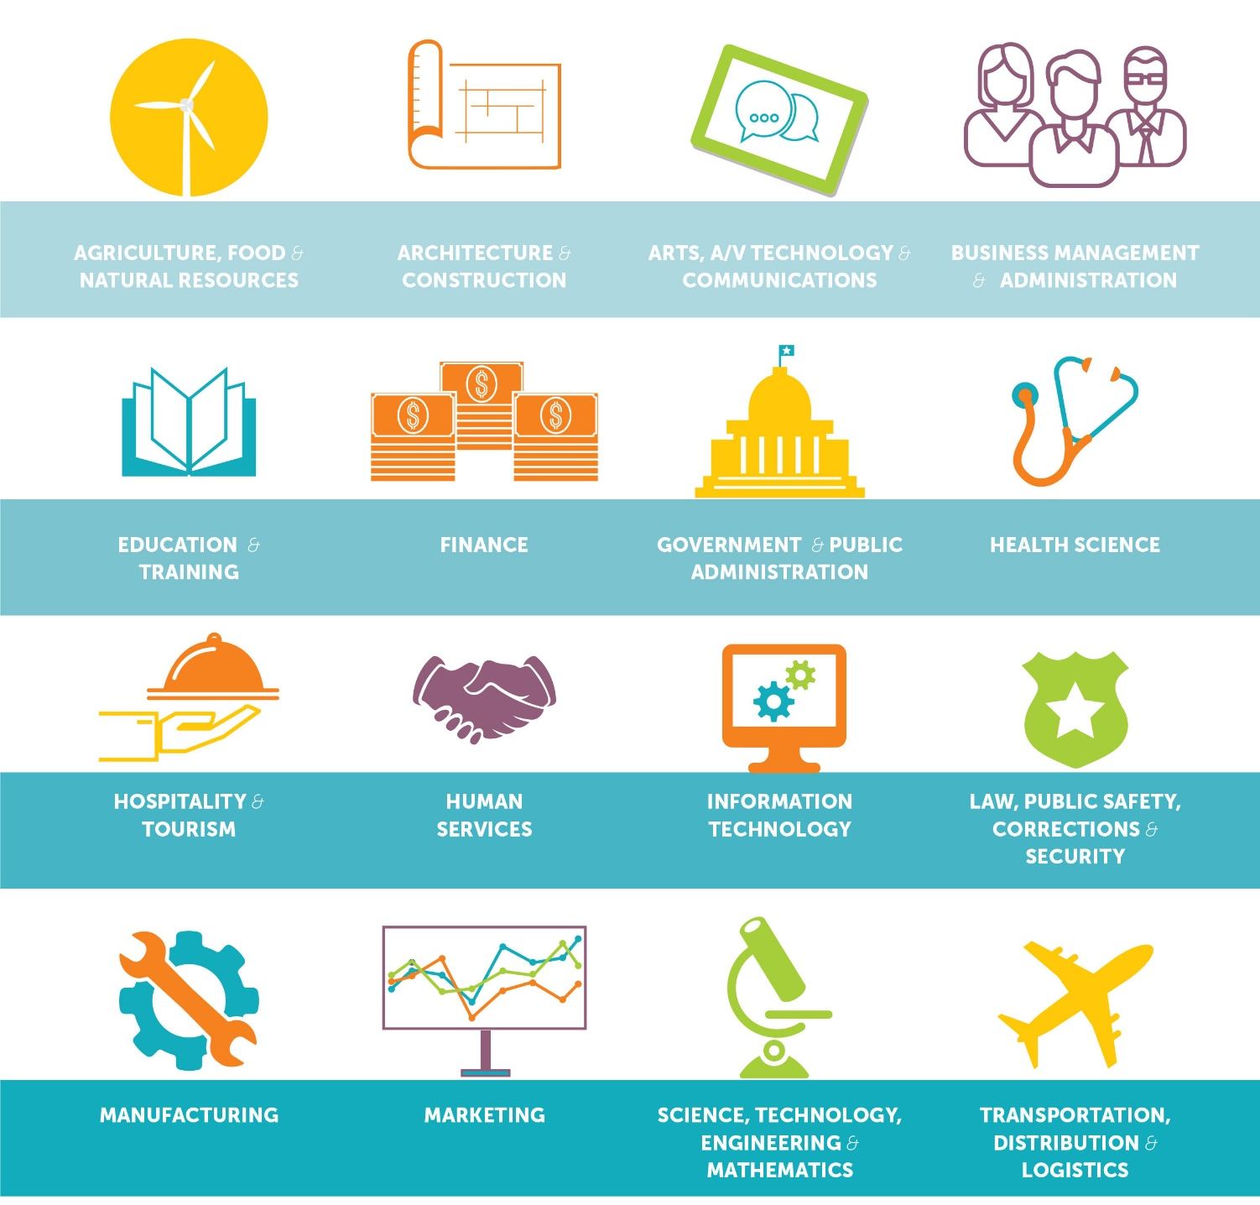
Career Clusters and STEM (Advance CTE)
Many of the 16 career clusters require STEM skills

Slide 7
2018: New CTE Update Strengthening the Career and Technical Education for the 21st Century Act
The purpose of this Act is to develop more fully the academic knowledge and technical and employability skills of secondary education students and postsecondary education students who elect to enroll in career and technical education programs and programs of study, by….
(3) increasing State and local flexibility in providing services and activities designed to develop, implement, and improve career and technical education;

Slide 8
What’s changed in Perkins V? (Advance CTE)
Program Improvement
Flexibility
Data & Accountability
Comprehensive local needs assessment
New national competitive grant program
Focus on labor market alignment
Retains governance structure
Expands support to middle grades
Alignment to ESSA and WIOA
State-determined performance levels
Focus on equity
Shifts in accountability indicators

Slide 9
Perkins CTE and Afterschool
Employability Skills
(Leadership)
Career Exposure and Exploration
Middle Grades
Non-traditional Fields
Intermediaries (Employer Engagement)
Innovation
Applied, Hands-On and Work-Based Learning
Notes:
The New Perkins V Law includes important updates for afterschool including:
Employability Skills: The law mentions the importance of employability skills in career development (like collaboration, communication, and problem solving).
Middle School Career Exposure: The law expands eligible uses to allow for career exposure, exploration and preparation, and it permits use of funds as early as the middle grades (fifth grade through eighth grade).
State Planning: As in the past, the law requires inclusion of interested community-based partners in the state planning process.
Working with Intermediaries: The law mentions partnerships with community-based partners within the definition of qualified intermediaries (non-profits that connect students with opportunities).
Eligible Uses of Local Funds: The law for the first time explicitly lists partnerships with community-based and youth-serving organizations as eligible uses of local funds.

Slide 10
Youth Serving Organizations Play a Role in CTE
State Planning
Local Planning and Needs Assessments
Eligible uses of Local Funds
Community Based and Youth Serving Providers
Notes:
To emphasize the importnace of partnerships the law discusses the involvement of community based and or youth serving partners in involvement at the state leval in planning at the local level with planning and the new needs assessment processes and at the level of using local funds for eligible collaboration with youth serving organizations

Slide 11
Federal Laws Support Work with Partners
CTE (2018)
Eligible uses of local funds includes – building relationships with community stakeholders including community based and youth serving organizations
Employability skills*
Middle Grades (5th)
Underrepresented students and nontraditional fields, STEM
* See the Afterschool Alliance Issue Brief: Building Workforce Skills in Afterschool
ESSA (2015)
College AND Career readiness focus
Accountability – Ex. North Dakota’s Essential skills: 2 or more co-curricular activities
21st Century Community Learning Centers – alignment with WIOA, CTE and workforce, STEM
WIOA (2014)
25% of funds for youth can be used for youth 14-21 who meet criteria
Many students need paid work – funding provides a pathway
Examples of locations innovatively braiding and blending (P3) funds
Children Services Council of Broward County*
WorkReady Philadelphia*
*See the AYPF Issue brief on Afterschool and Workforce: Opportunities for Systems Level Alignment

Slide 12
State Planning

Slide 13
State Plan Development & Submission Process (Advance CTE)

Slide 14
Department of ED CTE Pages

Slide 15
Dept of ED CTE Pages

Slide 16
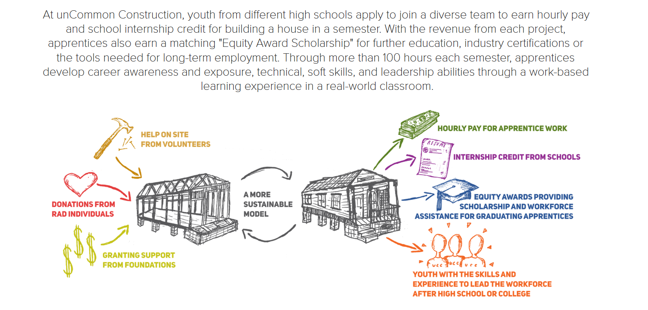
Example: uncommon Construction, LA

Slide 17
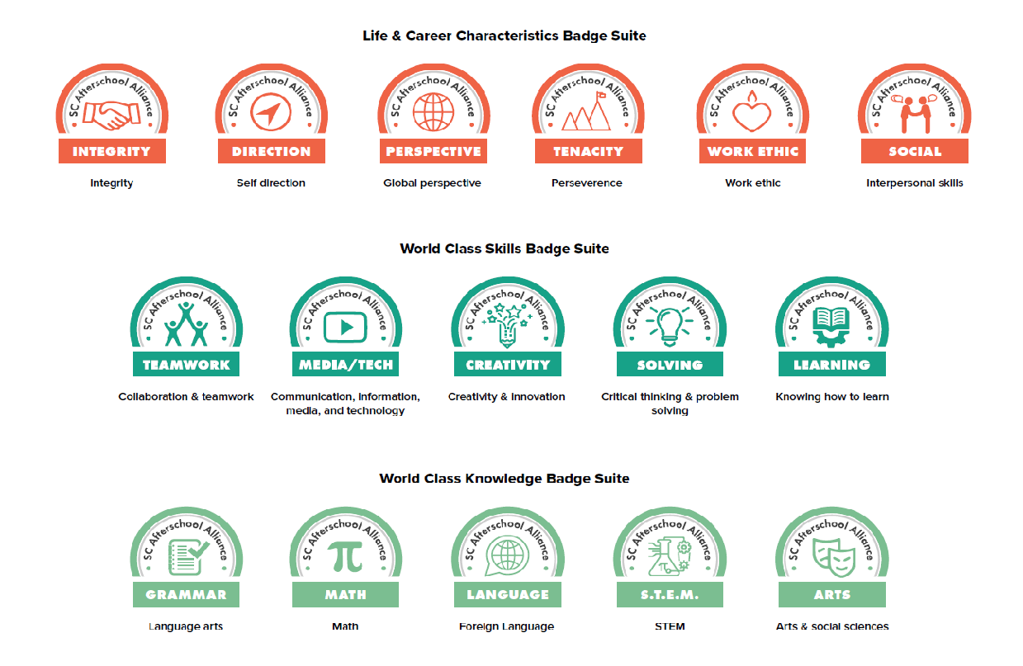
College and Career Digital Badging in South Carolina
How can we demonstrate how quality afterschool and summer learning programs contribute to college and career readiness?

Slide 19
Opportunities to engage in CTE planning and implementation

Slide 20
CTE

Slide 21
A 1-2-3 Toolkit for CTE Engagement
Reach out to your state CTE director
Sample Letter - Phone Call - Email (Do you have partners who can also send)
Tell them what you do and how afterschool supports students academic and career success
Use the language of the law where you can
Employability skills
Career exposure and middle grades
Intermediaries between school, business, parents, partners and the community
Non-traditional field exposure
(Careertech.org/state-director-list)
“Afterschool programs help schools develop the employability skills that employers are looking for in new hires, including critical thinking, communication, problem solving, and teamwork and collaboration.”
Need talking points – reach out to us!

Slide 22
A 1-2-3 Toolkit for CTE Engagement
2. Identify how your state uses funds
Identify how your state is using the state leadership activity funds
Discuss possible curriculum support
Discuss summer programs
Discuss other innovative methods of programming

Slide 23
A 1-2-3 Toolkit for CTE Engagement
3. Plan a local strategy
Inform the field about the local needs assessment process
Share the language and talking points around the law
Encourage them talk to their local director about the eligibility of youth serving organizations in the local uses of funds
Support them in sharing their stories and building relationships that help students find pathways to success in college, career and life

Slide 25
New Communications tools coming soon!
New messaging document for CTE
National one-pager for CTE w/program example and talking points
New CTE graphics for “This is Afterschool” campaign

Slide 26
Nebraska’s Statewide Expanded Learning Network

Slide 27
At Beyond School Bells (BSB), we believe that school-based and community-powered afterschool and summer programs, which we call expanded learning opportunities (ELOs), can serve as an early on-ramp for career exploration and are a valuable, albeit grossly underutilized, space for developing these important 21st century skills.

Slide 28
Partnering with State CTE Offices on STEM

Slide 30
Skills USA
SKILLS USA is a partnership of students, teachers and industry working together to ensure America has a skilled workforce.
Students involved in Skills represent a diverse group of individuals ranging from culinary arts to construction, and almost anyone in between.
Most towns in Nebraska have a Skills USA chapter that can be accessed by talking to high school administrators.
Skills USA students can help lead Maker clubs, teach or coding classes, lead culinary classes, build projects offsite for after school clubs to utilize (nothing is too big or too small).
If there is not Skills organization in your community, talk to the HS counselor about Industrial Technology classes, Family Consumer Science, or Engineering classes to find students who may be interested.

Slide 31
Contact Information
Jeff Cole – jcole@nebraskachildren.org
Jillian Luchner – JLuchner@afterschoolalliance.org
Chris Neitzey – cneitzey@afterschoolalliance.org
Jen Rinehart - jrinehart@afterschoolalliance.org

