Slide 1
Session 2B
Engaging the Business Community: Strategies from the Field

Slide 2
Speakers
Moderator: Tessie Topol, Consultant, Topol Consulting
Alysia Bell, Vice President Business Education Coalition, L.A. Area Chamber and the Association of Chamber of Commerce Executives
Susan Stanton, Network Lead, Afterschool for Children and Teens
Michelle Sullivan, Director, Wyoming Afterschool Alliance

Slide 7
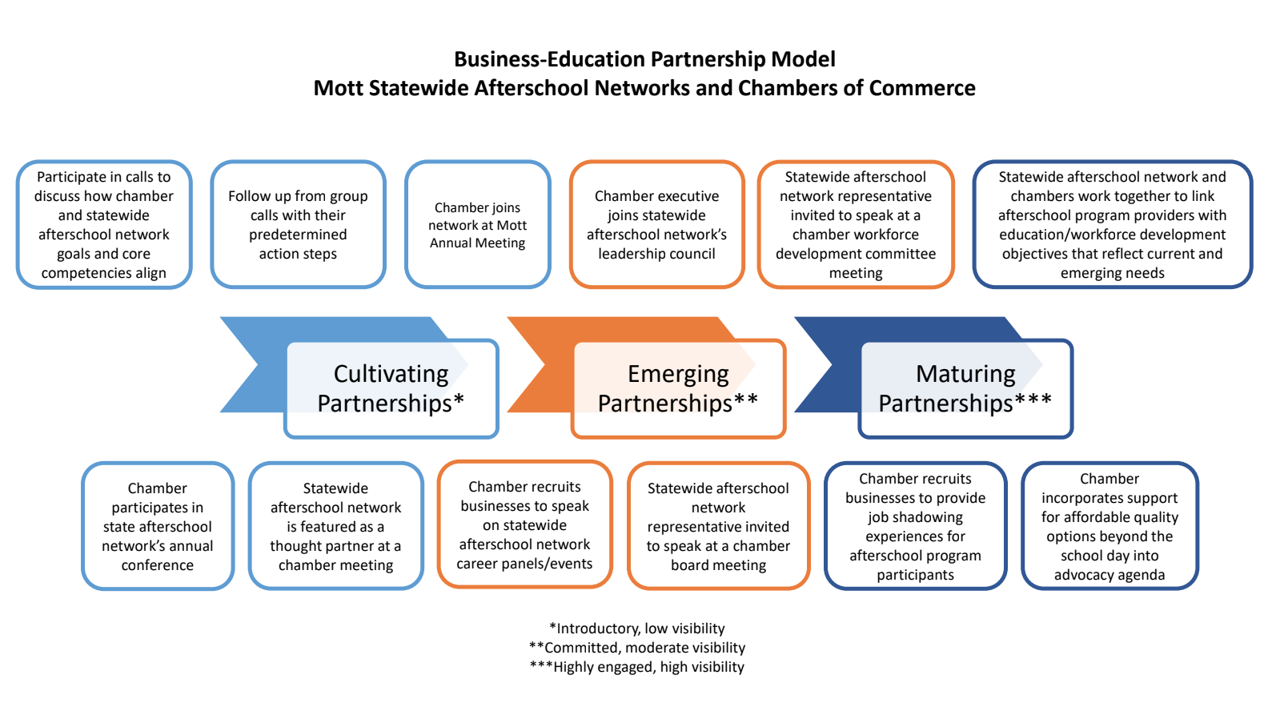

Slide 8
State Business Environmental Scan and Customizable Value
SUSAN STANTON, NETWORK LEAD, ACT NOW-IL

Slide 9
Where We Started: Environmental Scan
Sources
Forbes
IDES (IL Department of Employment Security)
Vital Signs
US Chamber Foundation
Governor’s Office
IL DCEO (Dept. of Commerce and Economic Opportunity)
Commission of Government Forecasting and Accountability
Illinois Center for Specialized Professional Support

Slide 10
Inside the Scan
Why we need a scan and where are our sources
State environment conditions
Talent/workforce/skills
Economic
Culture
Education
What are the leading, emerging and declining sectors in your state?
What are the links to afterschool and your Network?

Slide 11
Environmental Scan—Lessons Learned
The Lingo– employability skills
What are ACTUALLY the leading, emerging, and declining sectors in your state?
Who the big players are in our state

Slide 12
Value Proposition
Background on the Network
Defines why businesses should work with – written in their language
Hits the most important points
Customizable
Next steps
A leave-behind

Slide 13
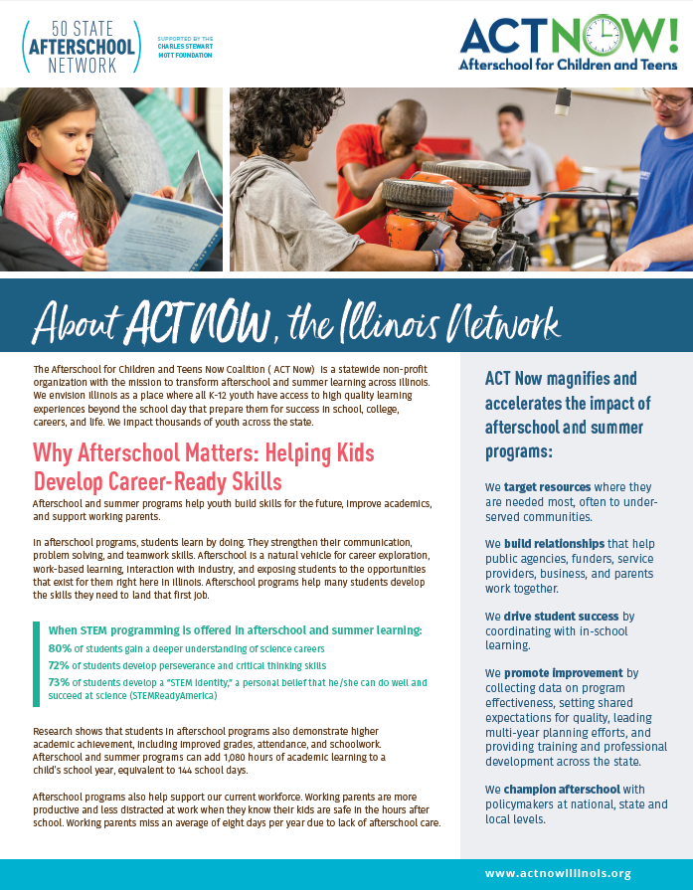

Slide 14
How We Used It
Apple meeting
Business engagement event
Chambers
Other businesses

Slide 15
Who Was Involved
Higher Ed
Business Owners
Retired State Agency Leaders
Providers
Career Readiness Curriculum Specialists
ATAC

Slide 16
Lessons Learned
We’re continuing to learn
Concrete activities to continue engagement
Listen!
Keep following up
People are excited about afterschool!

Slide 17
Thank You!

Slide 19
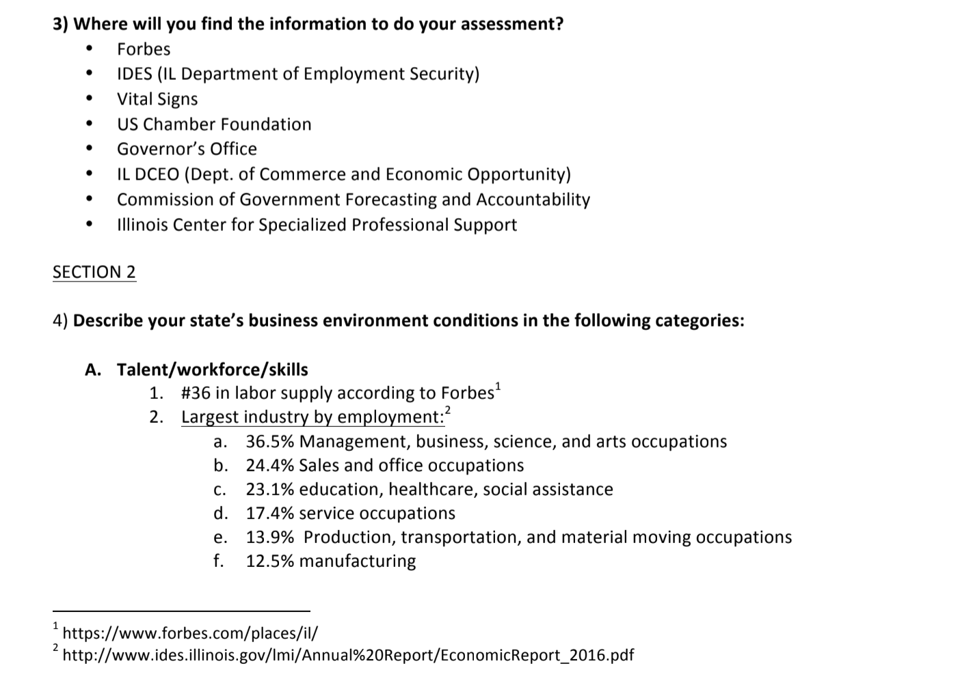

Slide 22
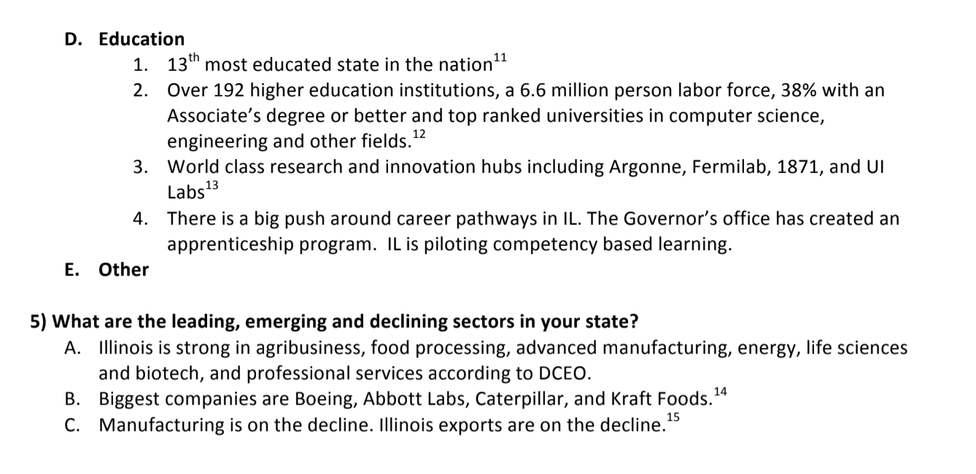

Slide 24
Contact Information
Tessie Topol - tessie@topolconsulting.com
Alysia Bell - abell@lachamber.com
Susan Stanton - StantonS@metrofamily.org
Michelle Sullivan - michelle@wycf.org

